Slide 1
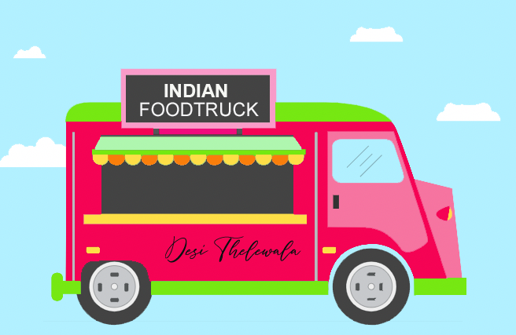


Desi Thelewala
ARC’s
Your Place for Vegetarian and Vegan food
Aakash Sardesai
Jesica Shah
Keya Keya

Slide 2

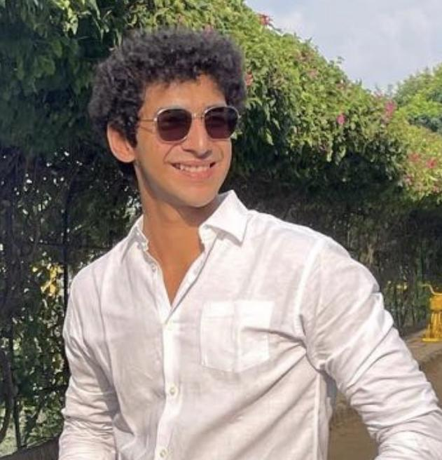




Our Team
Aakash Sardesai
Jesica Shah
Keya Keya
An adventurous globetrotter and foodie.
A positive influencer with an infectious personality.
A multi-talented ambivert and
movie buff.
Notes:
Our team welcomes you to join us for our mission to be the go-to food cart for plant-based food options with authentic flavor from the Indian subcontinent.

Slide 3
How Do We Do It?
Problem
Solution
Lack of healthy, convenient, and affordable options for individuals who follow a plant-based diet. While there are a variety of food trucks and restaurants in NYC, the options for vegetarian and vegan food are limited, and often not authentic Indian cuisine.
Offering a delicious and wide variety of authentic Indian plant-based options, using fresh ingredients, dishes made in a healthy way, affordable prices and available on-the-go for customers who are in rush.
Notes:
Jesica Shah
Problem: According to a survey conducted by the Vegetarian Resource Group, approximately 9.7% of adults in New York State identify as vegetarian or vegan, which is higher than the national average of 5%. Despite this growing demand, many individuals who follow a plant-based diet continue to struggle with limited options that are both healthy and affordable.
In terms of affordability, a 2019 study by the City University of New York found that the cost of a vegetarian meal was higher than that of a non-vegetarian meal in the majority of New York City neighborhoods studied. Additionally, a report by the American Heart Association found that plant-based diets can be more expensive due to the cost of fresh produce and other plant-based ingredients.
While there are a variety of food trucks and restaurants in NYC, the options for vegetarian and vegan food can be limited, especially when it comes to authentic Indian cuisine. According to a 2020 article in Eater New York, many Indian restaurants in the city offer limited or not-authentic plant-based options, with some relying heavily on dairy and meat-based dishes.
To address this issue, there have been several initiatives in recent years to increase the availability and affordability of plant-based options in NYC. For example, in 2019, New York City launched the Meatless Monday initiative in public schools, which aims to provide healthy, plant-based options for students. Additionally, the city has implemented the NYC Green Cart program, which brings fresh fruits and vegetables to underserved neighborhoods.
Despite these efforts, there is still much work to be done to address the lack of healthy, convenient, and affordable options for individuals who follow a plant-based diet in NYC. This includes addressing the high cost of fresh produce and other plant-based ingredients, incentivizing restaurants to create more authentic plant-based options, and increasing education and awareness about the benefits of plant-based diets.
Solution: Offering a delicious and wide variety of authentic Indian plant-based options can be a potential solution to the problem of the lack of healthy, convenient, and affordable options for individuals who follow a plant-based diet in NYC. Authentic Indian plant-based options can provide a flavorful and healthy alternative to meat-based dishes, and can help to meet the growing demand for plant-based options in the city.
Offering affordable prices can also be crucial in making plant-based options accessible to a wider range of customers. According to a report by the Plant Based Foods Association, plant-based food sales grew by 27% in 2020, indicating a growing demand for plant-based options. However, the high cost of fresh produce and other plant-based ingredients can make it difficult for some consumers to afford plant-based options. Therefore, offering affordable prices can help to make plant-based options more accessible to a wider range of customers.
Finally, making plant-based options available on-the-go can be important for customers who are in a rush. According to a report by the National Restaurant Association, 79% of consumers use restaurant takeout at least once a week. Therefore, offering plant-based options that are convenient and easy to take on-the-go can help to meet the needs of busy consumers. Overall, offering a delicious and wide variety of authentic Indian plant-based options, using fresh ingredients, dishes made in a healthy way, affordable prices, and available on-the-go can be a potential solution to the problem of the lack of healthy, convenient, and affordable options for individuals who follow a plant-based diet in NYC which problem we are trying to solve with help of our Indian food cart.

Slide 4

Our Company
We aim to bring authentic Indian flavors to the streets of New York City. Our menu is 100% vegetarian and we offer a wide variety of vegan options as well. We will provide delicious, affordable and healthy food options for people who are looking for a quick and satisfying meal.
Food Truck
Notes:
Jesica Shah
Welcome to our food truck, where we bring authentic Indian flavors to the streets of New York City. Our menu is 100% vegetarian, and we offer a wide range of vegan options as well. Our aim is to provide delicious, affordable and healthy food options for people who are looking for a quick and satisfying meal.
At our food truck, we use only the freshest and highest quality ingredients to create our dishes. Our chefs have years of experience in cooking Indian cuisine and are dedicated to bringing you the most authentic flavors possible. We take pride in serving food that is not only delicious but also healthy and nutritious.
Our menu features a variety of dishes from different parts of India, including classic street food items like sev puri, aloo tikki, and pav bhaji. We also offer more substantial meal options like dal makhani, misal pav, and rajma chawal. And of course, we have plenty of vegan options for our customers who prefer plant-based meals.
Our food truck is perfect for anyone looking for a quick, tasty, and affordable vegetarian or vegan meal in New York City. Whether you're a student on a budget, a busy professional, or just someone who loves good food, we have something for you. So come visit us and experience the true flavors of India on the streets of NYC.

Slide 5
Mission Statement
Food Party
“Our mission is to provide authentic and delicious Indian cuisine experience to people looking for vegetarian and vegan options, young Indian adults seeking pocket-friendly meals, and food explorers. We aim to become the go-to food cart for those who crave authentic flavors and cultural experience.”
Manhattan
Brooklyn
Notes:
Jesica Shah, Aakash Sardesai, Keya
To form the mission statement, we answered the following questions:
Question 1- What business are we currently in?
Answer - We are a food cart owner in New York City serving authentic Indian Vegetarian and Vegan food options to the customers.
Question 2 - Who are our customers, and what are they buying from us?
Answer - Our customers are people who want to have authentic Indian food that are also economic at pricing and who tries various ethnic cuisines.
They are buying different Indian dishes and cultural experience.
Detailed Customer Description for each location would be as followed: Washington Square Park and Times Square:
These are both popular tourist locations with people from all over the world. It will be difficult to describe one particular age group since people of all age groups visit these places. These customers will have different incomes and staying in different parts of New York City since one of the majority type of crowd here is also going to be the working professionals and students from universities like New York University and State University of NY. Tandon School of Engineering: The school has diverse student body including students from undergraduate, graduate and PhD. There are also faculty members and support staff therefore increasing the average age demographic for this area as well. This area is also surrounded by commercial buildings which will increase the customer base. Because of the varied background of customers, the age of customers is going to range from 17-80 years. Being at different stages in life, everyone will fall in different income slabs. Majority of students live in Manhattan, Brooklyn or New Jersey while professors and support staff might be travelling from nearby areas like Connecticut, Staten Island, Long Island, etc. Brooklyn Bridge Water Front:
Brooklyn Bridge is a popular tourist attraction and a commuter hub for residents of Brooklyn and Manhattan. The food truck may attract a mix of tourists, local residents, and workers from nearby offices and businesses. This gives food cart a diverse customer base with people from all ages including toddlers as well as senior citizens and people studying and living in different universities of New York.
Question 3 - How does our business go about satisfying our customers’ needs?
Answer - Our business goes above and beyond to satisfy our customers' needs by providing authentic cuisine, an economic meal plan, a vegetarian and vegan menu, and a cultural experience that transports our customers to the streets of India. We pride ourselves on our commitment to quality, affordability, and inclusivity, and strive to ensure that every customer leaves satisfied and eager to return.
Question 4 - What skills and capabilities is our business especially good at?
Answer - Firstly, we pride ourselves on our ability to deliver excellent customer satisfaction. We understand that customer satisfaction is critical to our success as a food cart business, and we have developed a range of strategies to ensure that our customers feel happy and content with their experience. We are friendly, approachable, and accommodating, and we listen closely to our customers' feedback to continually improve our service.
Secondly, we excel in market acquisition, continuously seeking out new customers and opportunities to expand our reach. We are always looking for ways to connect with our target audience and develop relationships with other businesses and individuals that can help us grow our brand and expand our customer base.
Thirdly, our business is particularly skilled in providing authentic cuisine. We are passionate about sharing the unique and flavorful tastes of Indian cuisine with our customers, and we have developed our menu to feature a range of authentic dishes that capture the essence of traditional Indian cooking. We use high-quality ingredients and traditional cooking techniques to create dishes that are rich, flavorful, and true to their cultural roots.
Finally, we are known for our quick service, providing customers with delicious food and efficient service that allows them to enjoy their meal quickly and conveniently. We understand that our customers lead busy lives, and we work hard to ensure that our food is delivered quickly and efficiently so that our customers can get on with their day. This combination of quick service, authentic cuisine, market acquisition, and customer satisfaction sets us apart and makes our business particularly successful in the food cart industry.

Slide 6
The Market Need
P
E
S
T
Growing awareness of benefits of plant-based diets.
Promotion through Government policies and initiatives .
Fast-growing industry sector
Increasing investment and innovation
A trending choice
Growing population of individuals choosing this diet
Social acceptance and popularity of Veganism and vegetarianism.
Advancements in food production and distribution technology
Advancements in plant-based food technology
Notes:
Keya Keya Desi Thelewala is attempting to meet a market need for nutritious, convenient, and inexpensive vegetarian and vegan options for people who eat a plant-based diet. This market need is indeed different than the problem, which is the shortage of such options available on the streets of NYC.According to a study by WalletHub published in 2018, nearly 16 percent of New York City’s restaurants serve vegan options and about 30.3 percent serve vegetarian options.These have the average price of $15 on the daily menu.
To further analyze the market need and the market environment for our Indian vegetarian and vegan food truck, we can use the PEST framework:
Political: There is a growing awareness of the benefits of plant-based diets for health and environmental reasons.As the climate change becomes worse ,individuals search for more sustainable food options.Plant-based diets can contain all nutrients needed for health, can decrease the risk of a number of chronic diseases, and require fewer natural resources for production.
In addition,government policies and initiatives that promote healthy eating, sustainability, and animal welfare may also have an impact on the market demand for vegetarian and vegan food.
For example, New York City has implemented policies such as Meatless Mondays in public schools to promote plant-based diets.
The Physicians Committee for Responsible Medicine (PCRM) petitioned the White House to promote plant-based diets in the 2025-2030 Dietary Guidelines for Americans in 2019.. The city council passed a bill in 2019 requiring all hospitals to offer plant-based meals to patients. This is the first legislation of its kind in the United States.
Sources : plantbasednews.org fda.gov foodtank dietaryguidelines.gov pcrm.org
Economic: The plant-based food industry is a fast-growing sector, with increasing investment and innovation in new products and technologies. There is also a trend towards healthier and more sustainable food choices among consumers, which may lead to increased demand for vegetarian and vegan options.
According to Meticulous Reasearch, in 2020, the plant-based food industry in the United States was worth $7 billion and is projected to reach $74.2 billion by 2027.
In New York City, there has been a significant increase in the number of vegan and vegetarian restaurants in recent years. The city now has over 200 vegan and vegetarian restaurants, according to HappyCow.
Sources : HappyCow United States Plant Based Food Market Report 2021-2027 (globenewswire.com)
Social: There is a growing population of individuals who follow a plant-based diet for various reasons, such as health, ethical, and environmental concerns. Veganism and vegetarianism have also become more mainstream and socially accepted in recent years, with more people adopting this lifestyle.
According to a survey conducted by Ipsos in 2020, 9.7% of New Yorkers identified as vegetarian, and 2.9% identified as vegan.
The number of vegan and vegetarian options at mainstream restaurants and fast-food chains has increased in recent years, reflecting a growing demand for plant-based options.
Sources : Vegan Society Poll | Ipsos Veganism | Ipsos Carbon Footprint| NYTimes
Technological: Technological advancements in food production and distribution, such as online ordering and delivery services, can make it easier and more convenient for consumers to access vegetarian and vegan options. Additionally, advancements in plant-based food technology can lead to the creation of more realistic and delicious meat substitutes, which may appeal to a wider range of consumers.
Online food delivery services such as GrubHub and Seamless offer a wide variety of vegetarian and vegan options for delivery from restaurants across the city.
Companies like Beyond Meat and Impossible Foods are creating plant-based meat alternatives that are increasingly popular among consumers. Many restaurants in New York City now offer dishes made with these products.
Sources: Forbes mdpi
Overall, the market need for healthy, convenient, and affordable vegetarian and vegan options is driven by a variety of factors, including changing attitudes towards health, environment, and animal welfare, as well as advancements in technology and innovation in the food industry.

Slide 7


Market Trends
526,133
39%
Highest Indian population in New York City among US
Of american population doesn’t label as vegan but trying to include plant-based diets
Plant-based market grew by 27% during the pandemic
2004
2019
30x increase in vegans in the United States between these years
Global Vegan food market is expected to expand at CAGR of 10.6% from 2022 to 2030
Notes:
Jesica Shah
Between 2004 and 2019, there was a 30-fold increase in vegans in the United States — from 290,000 in 2004 to almost 10 million in 2019³. The global vegan food market size was valued at USD 15.08 billion in 2021 and is expected to expand at a compound annual growth rate (CAGR) of 10.6% from 2022 to 2030⁶.
It seems that veganism has been on the rise in America for the past few years and it is predicted to continue growing in the future.
10% of U.S. adults identify as vegan or vegetarian. The plant-based market grew by 27% during the pandemic. It's worth noting that a surprising **39%** of the American population doesn’t label themselves as vegan but are actively trying to include plant-based diets in their lives. New York City has the highest Indian population in the US with 526,133 people. https://www.worldatlas.com/articles/top-10-us-metropolitan-areas-with-the-highest-population-of-indians.html
https://soylent.com/pages/vegan-statistics
https://getvegan.com/vegan-statistics/
According to a report by Research and Markets, the global vegan food market is expected to grow at a CAGR of 11.9% from 2021 to 2028, reaching a value of $31.4 billion by 2028.
The number of vegetarians and vegans in the United States has been steadily increasing in recent years. According to a report by Gallup, as of 2020, 5% of Americans identify as vegetarians and 3% identify as vegans.
The food truck industry in the United States is expected to grow at a CAGR of 3.7% from 2021 to 2026, reaching a value of $1.1 billion by 2026 (source: IBISWorld).
According to a report by the National Restaurant Association, food trucks have become increasingly popular in recent years, with 81% of consumers saying they have eaten from a food truck at least once.

Slide 8
Target Market Analysis
3.6M+
Expected net profit for first year
18-80
80%
$9.00
is the age range of our customers
of our customers are anticipated to eat from our food truck directly
is the average expense at our food truck
Notes:
Jesica Shah
Our main target market is the vegetarians and vegans of New York City area but if we divide our market further based on demographics, psychographics and behaviour, our proposal is as follows:
Demographics- Our food truck outside New York University (both campus) would cater to young workers and adults, students, foodies, tourists and health conscious individuals between the ages of 18 and 80 who either reside in or work nearby. This segment might include a variety of ethnicities, such as South Asians, Americans, Indians, and other ethnic groups that are open to attempting new foods.
Psychographics- People who are curious about other countries and cuisines, open-minded, and adventurous would be the psychographics of the target segment. They might enjoy experimenting with different foods and flavors, and they probably care about their health.
Behaviour- Depending on consumer behavior, the food truck plans to target those who want a quick and easy meal choice as well as those who want a place to hang out with friends or coworkers during lunch or after work. As Indian cuisine provides a variety of dishes that are not frequently found in other cuisines, the food truck will also target customers who are open to trying new and unusual spicy foods.
Based on the above analysis, we can divide our market segmentation as follows:
1. Young professionals (between the ages of 25 and 40) who work in the nearby office buildings and are frequently on the go and seeking a quick, inexpensive, and delicious lunch choice.
2. Nearby university students (ages 18 to 24), who are frequently on a tight budget but seeking a flavorful and unique eating experience. With students, faculty members as well as support staff will purchase food from the cart. Age group for them is going to be between the ages of 35-80.
3. Foodies (25–55 years old) who are eager to try new cuisines and will spend money on high-quality food.
4. Vegetarians and vegans seeking a variety of choices, who frequently choose Indian food because of the variety of vegetarian dishes it offers.
5. Travelers who are in the region and are seeking a distinctive and genuine culinary experience. These can range from toddlers to senior citizens and belong to different race and ethnicities.
6. People looking for healthy food choices who are health-conscious because Indian food frequently features a variety of fresh vegetables and spices.
7. People who like spicy food because Indian food is renowned for its use of flavorful spices.
Expected net profit for first year is explained in the next few slides Average food truck is based on the primary research we conducted.

Slide 9
4P’s
Promotion
Product
Price
Place
Online & Offline
Authentic Indian food options for the vegetarians and the vegans
Different prices for different product types
Total 4 locations in New York City
Notes:
Jesica Shah
We get to see overview of the 4Ps for our food truck. Detailed analysis for each P is mentioned in the following slides.

Slide 10



Time Square
Brooklyn Bridge Water Front
Washington Square Park
Tandon School of Engineering
Our Locations
Notes:
Jesica Shah
We plan to open our food truck in 4 locations as mentioned on the slide.
These are great locations since they are covered with all kinds of people from different parts of the world. Also it is always crowded which gives us more business opportunities. It is covered with people during daytime as well as night. Our 2 locations which are Washington Square Park and Tandon School of Engineering are covered with New York University Buildings which are home to alot of Indian Students. Also these buildings are covered with businesses which helps in increasing our customer base. This is one of our ideal locations because this park is covered with New York University buildings where a lot of Indian Students study. Also it is covered with businesses which will help in increasing our customer base. These locations are also a common tourist spot which helps in increasing the customers. One of the major reason for selecting Brooklyn Bridge Water Front is that there are hardly any options for vegetarians and everything shuts at 9pm. Our cart will be open till 12am and will help the visitors with their hunger. Similarly Times Square is our strategic 4th location choice since it attracts major tourist crowds during the night and office goers during the day.

Slide 11
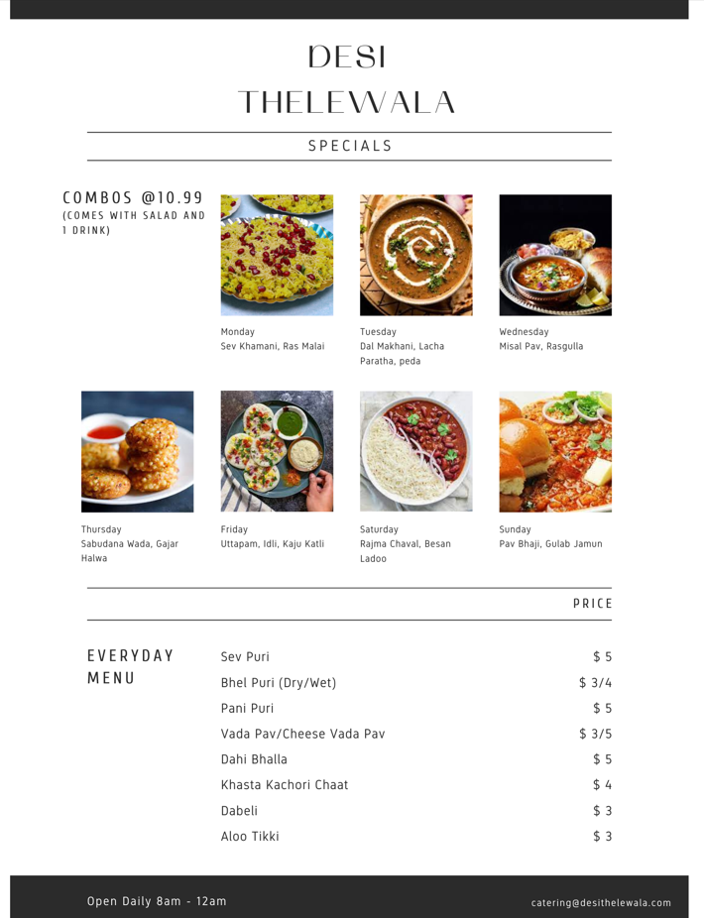
Product & Price
We have different types of products available at our truck
Specials menu is available on the mentioned days and we have a separate menu for everyday items
Drinks, Sweets and Breakfast specials are also available at our food truck
Notes:
Jesica Shah
This is our product list with price. It consists of our special combos which are different everyday. This is done to test the market. The specials menu changes each month and the most served dish gets added to the everyday menu.
We have basic everyday menu as well which is the same throughout the year expanding with the additions made each month depending on the star dish of the month. Our success is measured by the number of dishes sold each day, type of dish sold (example: is the dish from everyday menu or the specials, is breakfast menu being sold enough or should we shut it down and decrease our operating hours), retention rate and growth in customers each month. To measure our success we plan to maintain data of customers for what is being ordered and at what time. This practise will be maintained at least for the first year so we know the trend in each season as well. Also which items are preferred from our food truck dependending on the season.

Slide 12
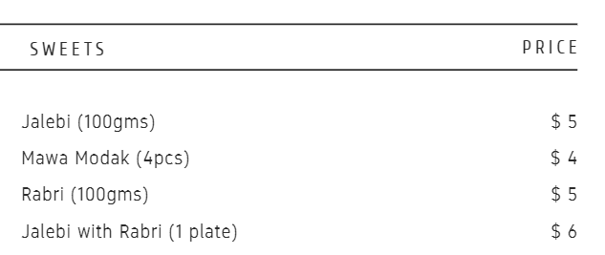
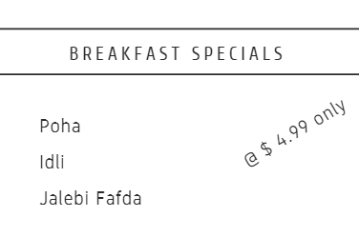
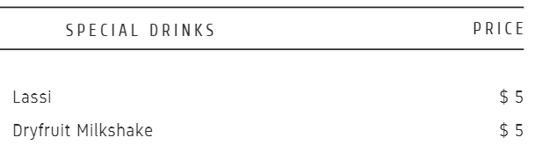
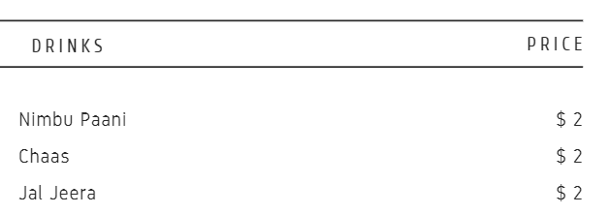
Notes:
Jesica Shah
These are other products available on our truck. We have breakfast specials for our targeted segment of students and young adults. All of our carts are located either near university or commercial locations where there will be people at all times of the day. Either students/office goers will be there or there will be tourists looking for food. Our price is such which is suitable for all of our customers since it is affordable range even if tourists convert it to their home country currency. As per our primary research, there are countries where operating hours for restaurants and food trucks are post midnight and someone coming here for the first time will assume the same. Majority of food options in New York City are shut around 9PM which makes it difficult to get food post that hour. Our food truck solves this problem by being available at prime locations till midnight. Our special emphasis with price and time is also on the quick service that we give our customers. There is one famous halal food cart for which people have to wait in que for around 2/2:30 hours which in a way decreases the retention rate for the cart despite of the food being tasty. We plan on customizing our menu and training our employees in a way which makes it quick and we plan to reach a stage where the wait time is less than 10 minutes for every customer. Every “HANGRY” (person angry because of hunger) customer is going to leave happily from our cart.

Slide 13

Promotion
20%
$5000
Of our promotion budget will be spent for social media marketing
is the average expense spent for promotion every year
0
400,000
50,000
50%
Additional plates anticipated to be sold every year.
Of the total market share to be captured because of promotion
Notes:
Jesica Shah
We plan to promote our truck by following ways: Social Media-Promote the position of the food truck and its daily specials using social media sites like Instagram, Twitter, and Facebook, and interact with followers. In order to receive updates on the position and menu items, encourage customers to follow the food truck on social media.
Flyers- To draw notice and advertise the location and menu items of the food truck, distribute posters around the nearby area's businesses, educational institutions, and tourist hotspots.
Local Business Partnership- Partner with nearby companies to give workers discounts.
Event Participation- To reach a larger audience and advertise the cuisine and services offered by the truck, take part in local events and festivals.
Influencer Marketing- To reach a larger audience, team up with local food bloggers and social media influencers to market the food truck.
Promotions and Discounts- Offer specials and deals to customers that encourage them to return to the food truck on a regular basis, such as loyalty programs and coupons.
Public Relations- To get publicity in articles, reviews, and listings of food trucks in the area, get in touch with local food journalists and publications.

Slide 14
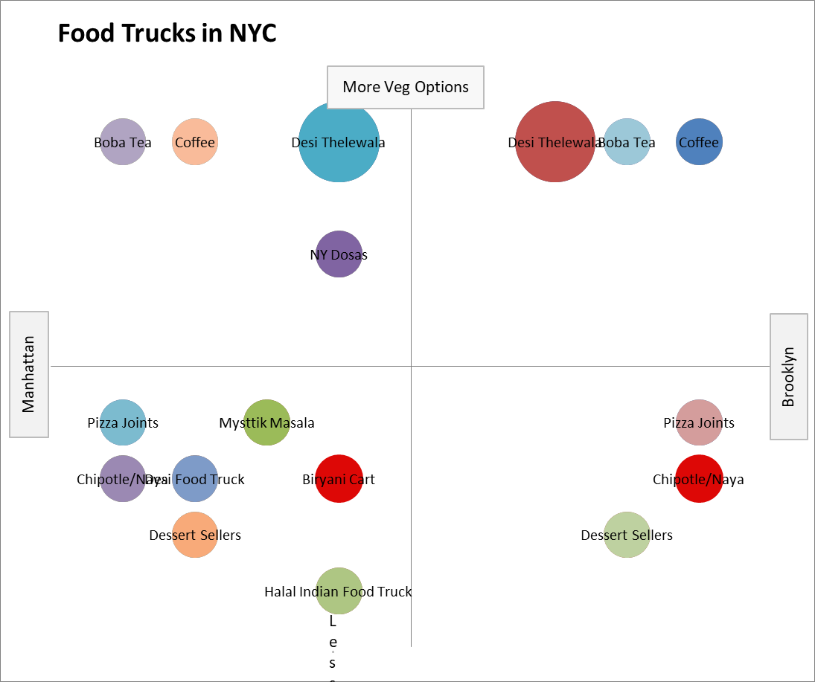
Perceptual Map
Food Options in NYC
Our food truck in comparison to other indian food sellers, different vegetarian/vegan options and beverage options since we are competing with the entire food industry in New York City and not just one niche from those options.
Notes:
Jesica Shah
Our main reason for opening the food truck is to cater to the vegetarians and the vegans because there are not much economic options available for them in New York City. We saw a opportunity since there are hardly any few trucks serving Indian vegetarian options in the Manhattan and Brooklyn area.According to US News, about 20.1% of restaurants in NYC have vegetarian options and 13.1% have vegan options but to find authentic Indian food at a reasonable price is a hunt!
Because of which we don’t have many competitors as well. We decided to take location and number of vegetarian food options as our parameters as that is our main goal. There are only few food trucks in the New York City Region serving indian food and out of which none of them are giving the food options that we have.
I have put two Desi Thelewala since we have trucks in Manhattan as well as Brooklyn. Similarly there are two Chipotle/Naya, Dessert Sellers, Boba Tea, Coffee, Pizza Joints as they are all easily available in all parts of Manhattan as well as Brooklyn. We have put vegetarian food options with different cuisines in our perceptual map since we are competing with the entire food industry and targeting people who are hungry in general. We have an advantage in comparison to these food places since we can get vegetarian food at these places easily but getting vegan food is very difficult. Even if vegan food is available, there are hardly 2 or 3 options from which the customer can choose.
Our reason for putting boba tea/coffee on our map is that it is easily available everywhere and a commonly purchased beverage. We are going to sell beverages at our truck but we have the benefit of price. Also other competitors are usually famous for milk based drinks while we have water based options as well. None of the competitors mentioned above are selling the products that are mentioned on our product list.

Slide 15

Financial Plan

Slide 16
Monetising Our Truck
Sell Food
Catering
Private Events
Merchandise
Take outs
Social Media
Notes:
Aakash Sardesai
Sell food: The primary way to make money with a food truck is to sell food. We can offer a variety of dishes to attract a diverse range of customers, and set competitive prices to maximize profits.
Catering: We can also monetize your food truck by offering catering services. Catering events such as corporate parties, weddings, and festivals can be lucrative sources of revenue, especially during peak seasons.
Merchandise: Selling merchandise such as t-shirts, hats, and other branded items to customers who want to support our food business and show off their loyalty.
Social media: Social media platforms such as Instagram and Facebook can be powerful tools to promote our food truck, attract new customers, and build a loyal following. We can monetize our social media presence by partnering with brands, running sponsored posts, and selling advertising space.
Delivery services: We can monetize the food truck by offering delivery services. Partnering with popular food delivery platforms such as Grubhub, Uber Eats, and DoorDash can help us reach a wider audience and increase revenue.
Private events: Finally, we can offer private events such as cooking classes, pop-up dinners, and private parties. These events can help us build a loyal customer base and generate repeat business.

Slide 17
Break-Even Analysis
Loss
$15
< $1118250
$10
Breakeven
$1118250
$5
Profit
$0
> $1118250
50k
100k
150k
200k
Notes:
Jesica Shah
On the graph above, x-axis is the number of customers and Y-axis is average money customers spend at our cart. Our total expenditure for all of our trucks is $1118250. This means that for us to reach break-even, we will have to have revenue of $1118250. Assuming as per our primary research that a customer is likely to spend an average of $9 at our food cart. With that calculation, if we serve 124250 customers then we will reach our break even point. Post that whatever we earn is going to be our profit.

Slide 18
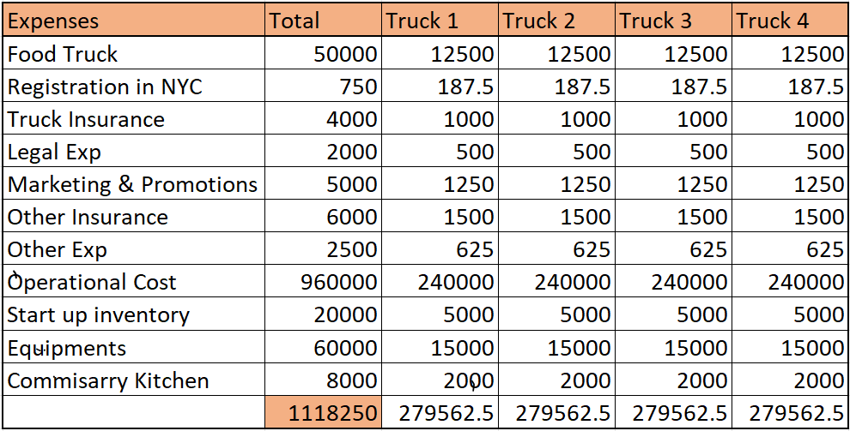
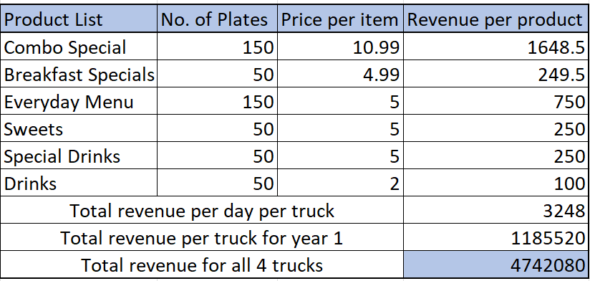
Revenue Prediction
Net
Profit
Total
Revenue
Total
Expenses
=
-
=
4,742,080
-
1,118,250
3,623,830
=
Notes:
Jesica Shah
We have used bottom-up estimates method to calculate our budget. Forecast of the sales is done on the basis of our secondary research. We do not want to over estimate the revenue so for that reason we have only considered direct sales from food truck to predict our revenue for the first year. For later years, we will also consider our revenue from catering and merchandise selling. Expenses are explained in detail below: 1. Food Truck - Purchasing of food truck 2. Registration in NYC- Total fee for registering the business 3. Truck Insurance - Insurance to cover the truck incase of any damages 4. Legal Expenses - Expense for obtaining licenses and permits as well as accounting services 5. Marketing and Promotion - Expenses undertaken to promote the product 6. Other Insurance - Includes insurance for general liability, workers’ compensation and property casualty and similar coverages 7. Other Expenditure - Includes miscellaneous expenditure like stationery, phone and utility deposits, etc 8. Operational Cost - Includes salaries for employees, fueling of the trucks, payment of utilities, etc 9. Start up Inventory - food ingredients, packaging materials, etc 10. Equipments - cost for store equipments such as counter area equipments, utensils and store euipments like cash register, digital payment method setup, ventilation, signage,etc 11. Commissary Kitchen - commercial kitchens available to rent from third parties which can be set up in any location such as a ghost kitchen

Slide 19
Market Analysis

Slide 20
Porter’s Five Forces Analysis
Bargaining power of suppliers
Threats of new entrants
Bargaining power of buyers
Competitive Rivalry
Threat of substitutes
Notes:
Keya Keya
Porter’s Five Forces Analysis is as follows:
1.Bargaining power of suppliers:
As the ingredients and spices are all Indian produce and would be imported, suppliers have a upper hand here and negotiations can be challenging.However, all other usage of local substitutes and equipments would help having some bargaining power over its suppliers.Overall, due to various local and regional suppliers food truck industry faces low bargaining power of suppliers.
Thus, a low force.
2.Competitive rivalry:
Due to the possibility of multiple other Indian restaurants or street food stands in the locality, our food cart may experience intense competition. This could put pressure . Yet, the impact of intense rivalry can be lessened if we could build a devoted customer base and a strong brand identity.
Thus,a high degree of competitive rivalry exists.
3.Threats of New Entrants :
The food truck industry in New York City has a low barrier to entry, making it easy for new competitors to enter the market.However,there are several food trucks competing for consumers in fiercely competitive food truck market. Industry sources estimate that there will be 5,000 food trucks operating in New York City by 2020. (source: New York Times).The unique food offerings and promotional strategies would be a differentiator.Indian food has also become more popular due to the growing trend of vegetarianism in America.However, the high initial investment required to establish a food business, along with the need for specialized skills and knowledge, can act as barriers to entry.
Thus,high degree of threats of new entrants.
4.Threat of substitutes:
ARC's Desi Thelawala may face a high threat of substitutes, as customers can choose from a variety of other cuisines and food options in the area. However, we offer unique and authentic Indian street food that is not easily replicated by other restaurants or food vendors and it can reduce the threat of substitutes in later years.
5.Bargaining power of buyers:
Because of the wide variety of street food options in the neighborhood, buyers at ARC's Desi Thelawala may have strong bargaining leverage. This could put pressure on prices and force to stand out in other ways, such via quality, customer service, or special services.All the selected locations are tourist spots and crowded in any fine day.Thus, the customers have a lot of options- cuisines, seating facility,price and quality.
Hence, a high bargaining power of buyers.
The color scheme in our slide is as follows:
Red : Low degree
Yellow : Towards the higher side but might decrement with time and efforts.
Green : High degree

Slide 21
Barriers to Entry
Limited availability of suitable permits and licenses
High competition
Operating costs
Limited resources
Brand loyalty
Access to ingredients
Regulatory hurdles
Notes:
Keya Keya
Barriers to Entry
Some potential barriers to entry in the Indian vegetarian and vegan food truck market in NYC include:
Limited availability of suitable permits and licenses: Obtaining the necessary permits and licenses to operate a food truck in NYC can be a lengthy and complex process, and there may be limited availability in certain areas.
High competition: The food truck industry is highly competitive, with many established players in the market. As of 2021, there were over 7,500 food trucks operating in the United States (source: IBISWorld). This high level of competition makes it difficult for new entrants to gain a foothold in the market.
Operating costs: Running a food truck can be expensive, with costs including vehicle maintenance, fuel, food and ingredient costs, and staff wages. New entrants may struggle to generate sufficient revenue to cover these costs and remain competitive.
Limited resources: Starting a food truck business requires a significant investment in time and resources, including purchasing or leasing a truck, acquiring equipment and supplies, and hiring staff. New entrants may struggle to secure financing or find suitable resources to start their business.
Brand loyalty: The Indian food market is highly competitive with established players who have built up loyal customer bases. It may be challenging for a new entrant to attract and retain customers without strong brand recognition or a unique selling proposition.
Access to ingredients: Indian cuisine is heavily reliant on authentic spices and herbs. Sourcing these ingredients may be challenging and expensive for a new entrant.
Regulatory hurdles: The food truck industry is heavily regulated in New York City, with strict rules and regulations governing everything from licensing to health and safety standards. This can make it difficult for new entrants to navigate the regulatory environment and obtain the necessary permits and licenses to operate.

Slide 22
STRENGTHS
WEAKNESSES
S
New brand
Limited menu
Only a single cuisine offered
Unique food offerings
Authentic Indian taste
Affordable pricing
Strategic Location
W
OPPORTUNITIES
O
THREATS
Ethnic and authentic food demand
Potential to expand
Collaborative promotion
Increasing Indian population in NYC
Online platforms
Positive growth rate of the industry
High Competition
Fluctuations in ingredients prices and supply
Changes in food and health regulations
Spending behavior of customers
Covid-19 pandemic
T
Notes:
Keya Keya
SWOT analysis for Desi Thelewala has been done according to the marketing plans and strategies.
Strengths:
Offerings of distinctive and authentic Indian street food are scarce in the chosen areas.All selected locations lack in Indian vegan food options and quick authentic street food.
High-quality ingredients and freshly made food.
The prices are reasonable.
Strategic location in Downtown Brooklyn,Times Square,Dumbo,Washington Square Park,with high foot traffic- tourist spots,universities,work places.According to NYC & Company, the official tourism organization for New York City, the city welcomed a record 66.6 million visitors in 2019, generating $72 billion in economic impact.According to the American Community Survey conducted by the US Census Bureau in 2019, there were over 150,000 people of Indian origin in New York City, making up approximately 1.8% of the city's total population.
Strong online presence and positive reviews on various platforms would add to our strengths.
Weaknesses:
New introduction in the market and thus, lack of popularity and familiarity compared to other established restaurants in the area.
Limited menu options, which may not appeal to a wider audience.
On a regular basis, the menu includes spices and ingredients that are catered to the Indian palate and would not appeal to clients who prefer other cuisines.
Opportunities:
Growing demand for ethnic and traditional cuisine.
Future potential for growth to other locations.
Possibilities to collaborate with local events and groups for publicity and promotion.
Increasing Indian population in NYC - office goers, students, residents which would help attract new customers. Asian American Federation reports that the Indian population in NYC has the highest proportion of children under 18 (20.7%). However, the share of seniors in the Indian population is growing: in 2020, they were 3.7 percentage points more of the total Indian population than in 2015.
Online marketing strategies are expected to aid in loyal customer base and high retention rate.
Representing a $1.4B market in the U.S. in 2022, the growth rate of the food truck industry is only expected to rise in the coming years.
Threats:
Competition from other restaurants and food vendors in the area
Fluctuations in ingredient prices and supply chain disruptions
Potential changes in food safety regulations and health guidelines that may impact business operations
Economic downturns or recessions that may impact consumer spending and decrease demand for eating out.
The pandemic has significantly impacted the food truck industry, leading to a decline in revenue and changes in customer behavior.

Slide 23
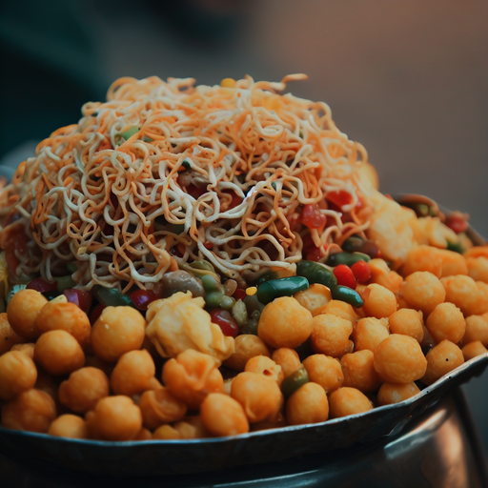
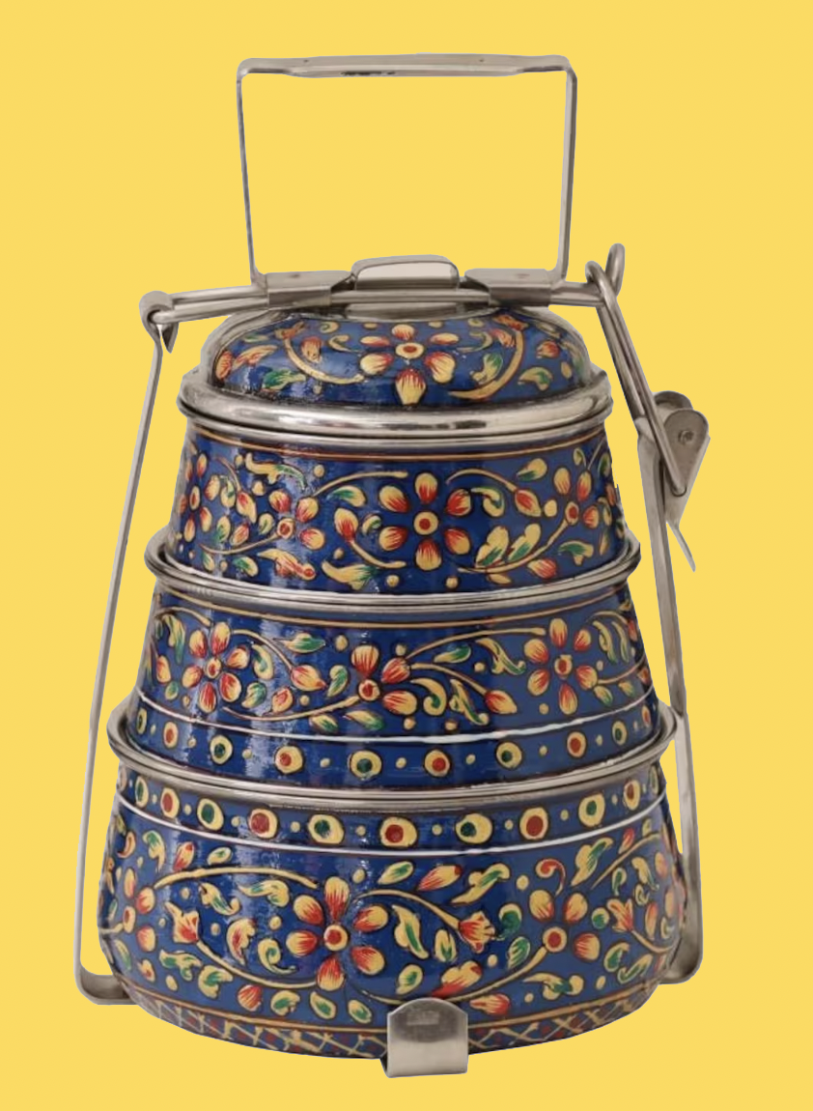



Unique Selling Proposition
Authentic Flavours Customisable dishes Seating Available Curated Menu Quick Service Healthy Options Affordable Prices
Notes:
Jesica Shah, Keya Keya, Aakash
Desi Thelewala food truck has a unique selling proposition that sets it apart from its competitors. One of the key features is the authentic Indian flavors that are infused into every dish. In addition, customers have the freedom to customize their meals, choosing from a range of ingredients to create the perfect flavor combination. The food truck offers seating for customers, making it a great option for those who want to sit down and enjoy their meals. The menu is also thoughtfully curated to include a variety of dishes that showcase the best of Indian cuisine. With quick service, customers can enjoy their meals in a timely manner without sacrificing quality or taste. For health-conscious customers, Desi Thelewala offers a range of healthy options that are both nutritious and delicious. And to top it off, all of these offerings come at an affordable price, making it a great option for budget-conscious foodies. Overall, Desi Thellewala's combination of authentic flavor, customizable dishes, seating availability, curated menu, quick service, healthy options, and affordable prices make it a top choice for those seeking a delicious and unique food experience in NYC.

Slide 24
Customer Analysis
Plant-based food trending
33%
1 in 8 tourist is vegetarian or vegan*
Vegan/Veg Tourists
20%
Millennials & Gen Z
Average fast food per week
247,000
Growing number of Indians
2-3 times per week
Notes:
Aakash Sardesai
According to a survey conducted by One Green Planet, 33% of Americans are actively trying to eat more plant-based foods.
Millennials and Gen Z are the largest consumers of vegan food, with 20% of millennials identifying as vegetarian or vegan. (Source: One Green Planet).
The average American eats fast food 2-3 times per week, and the most popular fast food chains in the US are McDonald's, Subway, and Taco Bell. (Source: QSR Magazine).
According to a report by Asian American Federation², there were 247,000 Indians living in New York City in 2020, based on data from the U.S. Census Bureau’s American Community Survey. This made Indians the third-largest Asian ethnic group in New York City after Chinese and Koreans.
According to a report by Statista³, there were 199,182 Indian students studying in the U.S. in 2021/22, making India the second-largest country of origin for international students after China.
2019-2020 academic year, there were approximately 22,000 Indian students enrolled in higher education institutions in New York State, including both public and private institutions.
Tourists
●According to a report by the New York State Comptroller's Office, over 80% of visitors to New York City come from Latin America or Asia. Based on the average percentage of vegetarians/vegans in these regions, it can be estimated that 15% of the majority tourists are vegan. Report by the New York State Comptroller's Office: https://www.osc.state.ny.us/reports/osdc/tourism-industry-new-york-city
●In 2022, there were 56 million tourists in New York City, with 80% of them coming from Asia and Latin America roots, which translates to 44.8 million Asian and Latin tourists. Based on the percentage of vegan/veg tourists estimated earlier, it can be concluded that there were 6.72 million vegan/veg tourists in New York City in 2022. Average veg/vegan % in Asia: https://en.wikipedia.org/wiki/Vegetarianism_by_country. Latin America: https://www.tritonmarketresearch.com/reports/latin-america-plant-based-food-and-beverage-market. Number of tourists in 2022: https://www.ny1.com/nyc/all-boroughs/news/2022/03/31/data-shows-massive-surge-in-nyc-tourists-in-2021
●Therefore, approximately 1 in 8 tourists in New York City is vegan/veg. Additionally, the majority of tourists prefer to stay in Manhattan and Brooklyn, according to Trip Advisor.https://www.tripadvisor.com/TravelersChoice-Destinations-cTop-g60763

Slide 25
Direct Competitors
Indian Foodtrucks
Vegan Restaurant
Veg Restaurant
Food trucks which serve indian cuisine
Restaurants which serve vegan cuisine
Restaurants which serve vegetarian cuisine
Avg meal price at Veg/Vegan restaurants: $15+
Notes:
Aakash Sardesai
There are several vegan and vegetarian food trucks in NYC, including some of that offer Indian cuisine, such as the Cinnamon Snail and Mysttik Masaala. But at the same time, there are very few which provide Veg/vegan Indian fast food at an affordable price. Following are some of the Indian food truck: Desi Food Truck: This food truck offers a variety of Indian street food items such as samosas, pakoras, chaat, and kebabs. They also offer a few vegetarian options, including aloo tikki, chana masala, and veg biryani.
The Kati Roll Company: This food truck offers a unique Indian street food item called the kati roll. It is a wrap filled with various fillings such as paneer, mixed vegetables, and chana masala.
Mysttik Masala: This food truck offers a fusion of Indian and Mexican cuisine, offering items such as naan tacos and burritos filled with Indian spiced vegetables.
Masala Times: This food truck offers a range of Indian street food items such as vada pav, pav bhaji, and dosas. They also offer a few vegetarian options such as paneer tikka and aloo gobi.
Desi Grill: This food truck offers a variety of grilled items such as tandoori chicken, seekh kebabs, and paneer tikka. They also offer a few vegetarian options such as grilled mixed vegetables and paneer tikka.
Spicey Grill: This food truck offers a variety of Indian street food items such as samosas, chaat, and parathas. They also offer a few vegetarian options such as chana masala and aloo gobi.
Dosa Delight: This food truck offers a variety of dosas, a South Indian crepe made from rice and lentil batter. They offer a few vegetarian options such as masala dosa and paneer dosa.
All of the above apart from dosa delight serve non vegetarian
Vegan Restaurants:
According to a Bloomberg article, New York City has more than **1,400 restaurants and food venues** offering vegan dishes¹. https://www.bloomberg.com/news/articles/2022-09-16/the-best-new-guard-vegan-restaurants-in-new-york-city-in-2022 Accessed 23/04/2023.
According to a Bloomberg article, some of the best new-guard vegan restaurants in New York City in 2022 include Spicy Moon** and Aunts et Uncles⁵. Another source lists some of the best vegan restaurants in NYC as Delice & Sarrasin, Buddha-Bodai, Peacefood Café, Ras, Beyond Sushi, Le Botaniste, Modern Lov, and Screamer’s Pizzeria¹.(1) The Best New-Guard Vegan Restaurants in New York City in 2022 - Bloomberg. https://www.bloomberg.com/news/articles/2022-09-16/the-best-new-guard-vegan-restaurants-in-new-york-city-in-2022 Accessed 23/04/2023.
Veg Restaurant:
Ahimsa, Bengal Tiger Indian Food,Vatan Indian Vegetarian, Saravanaa Bhavan, Pongal, Divya’s Kitchen, Alachi Masala, Saar Indian Bistro
For a casual vegan meal such as a burger, sandwich, wrap, salad, or bowl, you can expect to pay around $10-$15 per person at places like Urban Vegan Kitchen¹, Veggie Castle¹, GreediVegan¹, or Anixi².

Slide 26
Indirect Competitors
Pizza
Bagels
Juices
Boba Tea/Coffee
Chipotle/Naya
Desserts
Joints like dollar slices, Joe’s, Papa Johns, Dominos, etc
One of the famous breakfast option in New York City
Juice bar like Agavi, Baya Bar, Healthy Green Juice Bar
Sellers like Starbucks, Dunkin Donuts, Gong Cha, etc
Popular food joints like these that have vegetarian food option
Places that sell donuts, ice cream, cakes, pancakes, etc
Notes:
Aakash Sardesai
Desi thelewala, an Indian food truck in NYC, also has indirect vegan/vegetarian food competitors. These include pizza joints like dollar slices, Joe's, Papa John's, and Domino's, which offer vegetarian options. Another indirect vegan/vegetarian competitor is bagel shops, such as Ess-a-Bagel or Russ & Daughters, which offer vegan spreads like hummus or avocado. Juice bars like Agavi, Baya Bar, and Healthy Green Juice Bar also compete indirectly with Desi thelewala, offering fresh and healthy vegan drinks. Boba tea and coffee sellers like Starbucks, Dunkin Donuts, and Gong Cha also offer vegan options. Additionally, popular food joints like Chipotle and Naya have vegetarian options, while dessert places that sell donuts, ice cream, cakes, and pancakes can also compete indirectly with Desi thelewala.

Slide 27




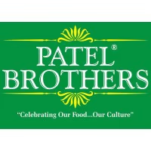
Our Major Collaborators
Events
Delivery
Services
Supplier
Social Media Influencers
Notes:
Aakash Sardesai
Weddings
The average wedding catering cost in the U.S. is about $4,000 with most couples spending between $1,800 to $7,000¹. However, in NYC, the average wedding catering cost may be higher due to the higher cost of living and venue fees. According to one source², if you want your wedding venue to include catering, you might be spending closer to $20,000-$100,000+ (depending on the venue and your guest count).
Corporate events:
The average cost per person for catering a corporate event may range from $20 to $100 or more², depending on the menu options, beverages, staffing, and rentals. Some catering companies may offer packages or discounts for large groups or repeat clients.
Social Media Influencers
92 percent of customers trust a micro-influencer more than a traditional ad or an endorsement from celebs. Over 82 percent of consumers are likely to buy something a micro-influencer recommends³. https://www.ana.net/blogs/show/id/mm-blog-2020-02-micro-influencers-better-content
Patel brothers:
Patel brothers is a famous new york store which sells authentic indian ingredients. We plan to collaborate with them to utilize economies of scale of purchase items at a cheaper price.
Social Media Influencers:
We plan to collaborate with micro to and macro influencers to ensure that our reach and brand awareness is optimized.

Slide 28
Strategy Selection Outline
Account Date : 23 April 2023 | Indian Food Lovers | Students and Professionals | Food Explorers | Rationale/Basis of Preference
Product Class Definition(for all strategies) | Foodies- who are eager to try new Indian food | Young adults with looking to have snacks and wholesome meals with relatable taste profile | Food explorers are the people who want to try and explore new authentic cuisines. | Students and Professionals willing to have authentic Indian food
Target Group Selection | Age group: all ages | Age group: 18-40; Students and working professionals | Age group: All age group; Tourists, Residents, International Students | Age group: 18-40; Students and professionals from indian roots
Message Element Selection | Authentic Indian flavors Customisable options Wide-variety of selection Affordable prices Convenient location | Good price point for fulfilling meals Authentic taste Moderately quick | Fresh Ingredients and Regional Variety Friendly service Authentic Indian flavours | Good price point for fulfilling meals Authentic taste Fast Service Demographics of the area
Rationale based on Information and/or Judgement | Authentic Indian cuisine Authentic spices imported An experience of goodness of cultural food Foodies loves exploring | Students and young professionals looking for quick, authentic and wholesome meals such as lunch and dinners. They also love street food with unique flavors which remind them of their roots. | Unique dining experience Budget friendly options for the tourist Locally sourced ingredients making it authentic and a unique selling point | A lot young adults from Indian roots study and work in premier institutions. They crave quick, authentic and wholesome Indian meals and Indian street food. According to a report by Asian American Federation², there were 247,000 Indians living in New York City in 2020.
Notes:
Aakash Jesica Keya
To ensure our success in these new markets, we have identified three key target audiences: Indian food lovers, students & professionals, and adventurous food explorers. Our strategy selection outline will help guide our decision-making process as we tailor our marketing and menu offerings to each of these audiences.
Indian Food Lovers:
• Offer authentic Indian dishes that are popular with traditional Indian cuisine enthusiasts, such as pav bhaji, missal pav, chaat, gulab jamun, etc.
• Use high-quality ingredients and traditional cooking methods to ensure the taste and flavor are true to the Indian food culture.
• Promote our cart on social media platforms popular among the Indian community and leverage word-of-mouth marketing to attract customers.
• Consider partnering with local Indian businesses or organizations to promote our cart and create community awareness.
• Host special events or offer promotions during popular Indian festivals, such as Diwali or Holi, to attract and engage Indian food lovers.
Students and Professionals:
• Offer affordable meal options that cater to the budget-conscious demographic in downtown Brooklyn and mid-town Manhattan.
• Create a special breakfast and lunchtime menu that is quick and easy to grab-and-go, catering to the busy schedules of students and professionals.
• Offer vegetarian and vegan options to cater to health-conscious and environmentally aware customers.
• Utilize social media platforms such as Twitter and LinkedIn to target students and professionals in the area.
• Partner with nearby colleges and universities to promote our cart as a convenient and affordable lunch option for students.
Food Explorers:
• Offer a variety of Indian street food dishes that are not commonly found in the mainstream market, such as Misal Pav, sabudana wada, rajma chaval and chaat.
• Utilize foodie and travel blogs to promote our cart and create awareness among adventurous food explorers.
• Offer small portion sizes and encourage customers to try multiple dishes to showcase the diverse flavors and dishes of Indian street food.
• Create a social media campaign that focuses on the sensory experience and excitement of trying new and exotic flavors.
By tailoring our marketing and menu offerings to each of these key target audiences, we can position our Indian food cart as a go-to destination for authentic Indian cuisine, and unique street food options. With a strategic approach, you can attract and retain a diverse customer base in both downtown Brooklyn and mid-town Manhattan, and ultimately grow our business.

Slide 29
Marketing Objectives
Increase brand awareness
Increase customer base
Enhance customer experience
Enhance customer loyalty
Increase
Revenue
Expand into new markets
Notes:
Keya Keya
The marketing objectives for the Desi Thelewala would be:
Increase brand awareness: One of the primary marketing objectives for Desi Thelewala could be to increase brand awareness among the target audience in NYC. This could be achieved through targeted advertising, social media campaigns, and other promotional activities that highlight the food truck's unique value proposition and offerings.
Increase customer base: Another objective could be to increase the food truck's customer base by attracting more individuals who are interested in vegetarian and vegan cuisine. This could involve identifying key customer segments and tailoring marketing efforts to reach them effectively.
Enhance customer experience: The food truck aims to enhance the overall customer experience by providing a welcoming and comfortable atmosphere, creating a visually appealing food presentation, and offering high-quality food that meets customers' dietary needs and preferences.
Enhance customer loyalty: Desi Thelewala would also focus on building customer loyalty by providing excellent customer service, offering special promotions and discounts, and developing a rewards program to incentivize repeat business.
Increase revenue: Ultimately, our aim is to increase revenue and profitability for the business. This could involve implementing effective pricing strategies, promoting high-margin menu items, and maximizing sales during peak hours and events.
Expand into new markets: Another objective could be to expand into new markets within NYC by identifying high-traffic areas and events where the food truck can set up shop. This could involve partnering with local businesses and organizations to promote the food truck's offerings and build brand awareness.

Slide 30

Market Share
Targeted
10%
for the first year
Desi Thelewala
Notes:
Keya Keya
The reasonable market share that we aim for the first year of Desi Thelewala would 10%

Slide 31
Key Metrics
Brand Awareness
Sales Revenue
Retention Rate
Customer Experience
Market Share
1000 followers on social media platforms
$2,000,000
50%
Excellent
5% for the first year
Notes:
Keya Keya
To measure the success of the marketing objectives, the following metrics will be used:
Brand awareness: The number of social media followers, engagement rate, and reach will be tracked. The number of referrals from local businesses and communities will also be tracked.
The food truck should have at least 1,000 followers on social media platforms and regular engagement with customers through social media.
Sales revenue: Sales revenue will be tracked on a weekly and monthly basis. The profitability of each menu item will also be tracked.
The food truck should generate a minimum of $2,00,000 in revenue within the first year.
Retention rate : The number of new customers, repeat customers, and customer retention rate will be tracked.
At least 50% of customers should return to the food truck for a second visit within the first six months.
Customer experience: Customer feedback will be collected through surveys and online reviews. The number of positive reviews will be tracked, and any negative feedback will be addressed promptly.
Customer feedback and reviews should demonstrate high levels of satisfaction with the food, service, and overall experience.
Market Share: We would also monitor our market share and aim to capture a 5% share of the vegetarian and vegan food market in the target area within the first year of operation.
This should increase steadily over time, reaching 15% within the first three years.

Slide 32
Marketing Strategies and Tactics
Internal
External
Social media presence
Food festivals and events
Offer promotions and discounts
Online directories and review sites
Employee training program
Strong relationships with suppliers
Offer incentives
Notes:
Keya Keya
a. Internal strategies and tactics:
Implement an employee training program to ensure consistent quality and customer service - rationale: well-trained employees can deliver better customer experience, which leads to increased customer loyalty and positive word-of-mouth.
Develop strong relationships with suppliers to ensure consistent and high-quality ingredients - rationale: quality ingredients lead to better food, which in turn leads to higher customer satisfaction.
Offer incentives to employees who refer new customers - rationale: incentivizing employees to refer new customers can increase word-of-mouth marketing and customer acquisition.
b. External strategies and tactics:
Create a social media presence on platforms such as Instagram and Facebook to showcase the food and engage with potential customers - rationale: social media can be a powerful tool for creating buzz and generating interest.
Participate in local food festivals and events to reach new customers - rationale: food festivals and events provide an opportunity to showcase the food and attract new customers.
Offer promotions and discounts to first-time customers to encourage trial and repeat business - rationale: incentives can help drive new customer acquisition and encourage repeat business.
Online directories and review sites : We could list our food cart on online directories and review sites like Yelp to increase the visibility.

Slide 33


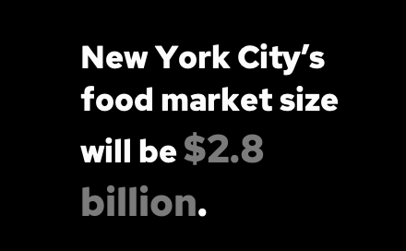


Market Size
SAM
SOM
Notes:
Aakash Sardesai
TAM SAM SOM
• TAM: The World Population Review says that in 2020, about 8.4 million people will live in New York City. With an annual growth rate of 0.5%, 8.6 million people are likely to live in New York City by 2023. If the national average for non-white people is that 9% of them are vegetarians, then there will be about 774 thousand vegetarians in New York City by 2023, based on the national averages. If we assume that they spend an average of $10 per day on food, like people in the rest of the country, the vegetarian food market in New York City will be worth $2.8 billion by 2023 ($10 x 365 x 774 thousand).
SAM (Serviceable Available Market), you need to narrow down your target market by location. World Population Review says that by 2023, there will be 2.58 million people living in Brooklyn and 1.63 million people living in Manhattan. Assuming that these boroughs have the same number of vegetarians as the city as a whole (9%), there will be about 232 thousand vegetarians in Brooklyn and 147 thousand in Manhattan by the year 2023. If we assume that they also spend an average of $10 per day on food, the SAM for Brooklyn and Manhattan will be $1.38 billion by 2023. ($10 x 365 x (232 + 147) 1000).
SOM: Desi Thelewala wants to open four foodtrucks in New York City by 2023. If we assume that each restaurant serves an average of 100 people per day 7 days a week, they will serve about 146 thousand people per year by 2023. (100 x 365 x 4). If we assume that each customer spends an average of $10 per meal, these restaurants will make about $1.5 million a year. We assume $10 spend per meal because the customer base near the food trucks include working professionals and students.
1. census.gov
2. wallethub.com
3. en.wikipedia.org
4. news.gallup.com

Slide 34
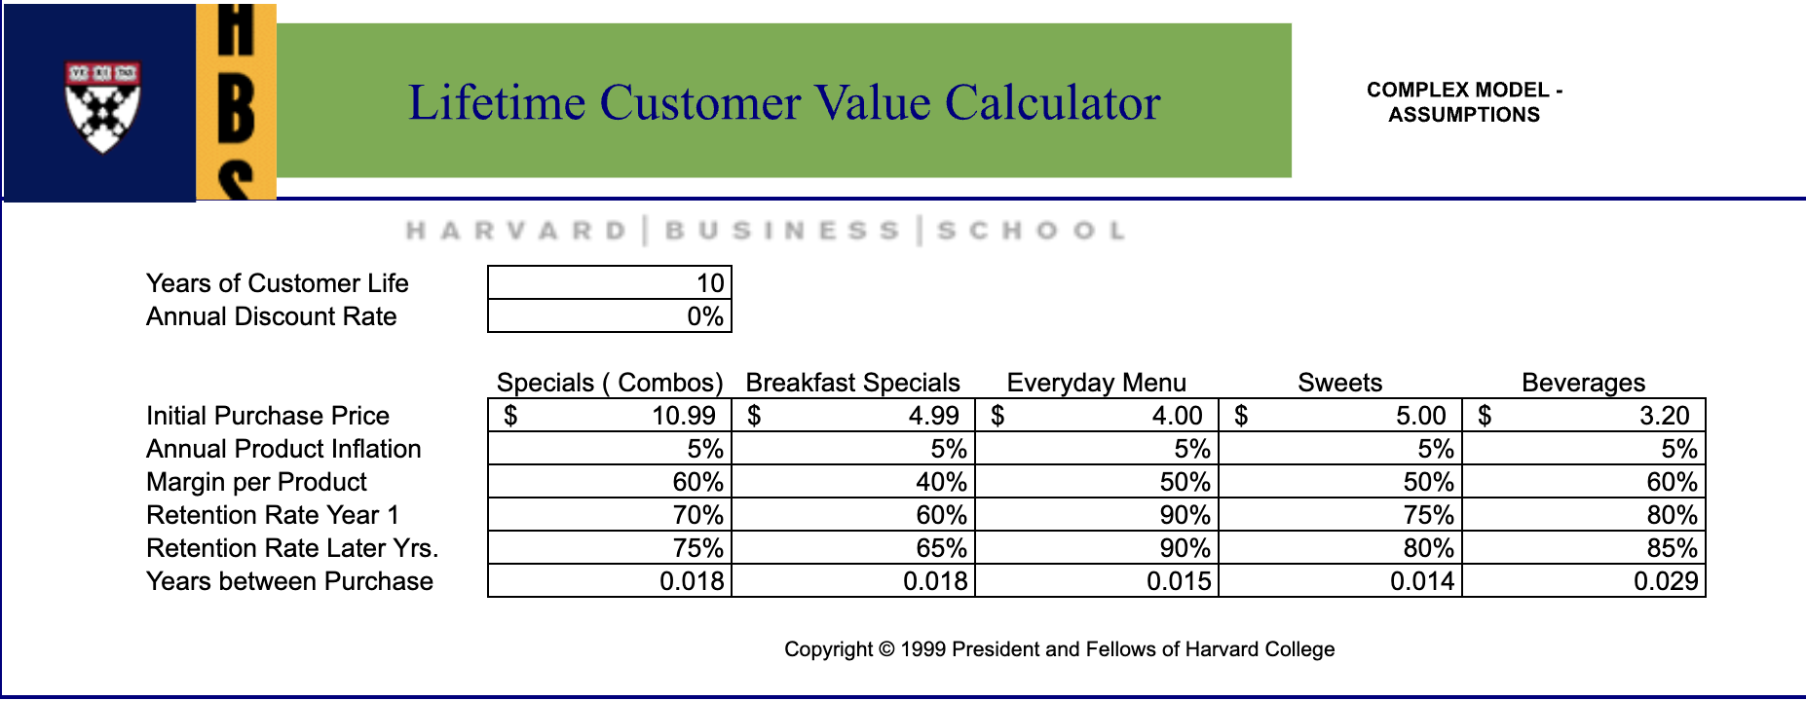
Notes:
Keya Keya For ease of calculation, we have assumed 10 years for customer life since our target segment includes students and working professionals who might migrate to different cities for jobs. We have used the complex model since we have different pricing structure for different products. We have bifurcated all of our products into 5 broad categories which are Combo Specials, Breakfast Specials, Everyday menu, Sweets and Beverages. We have assumed the values for annual product inflation, retention rates and years between purchases based upon our primary and secondary research. Margin per product is calculated based upon our pricing budget which is explained in the previous slides.

Slide 35
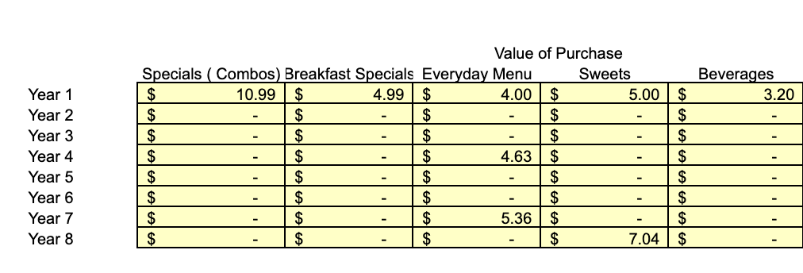
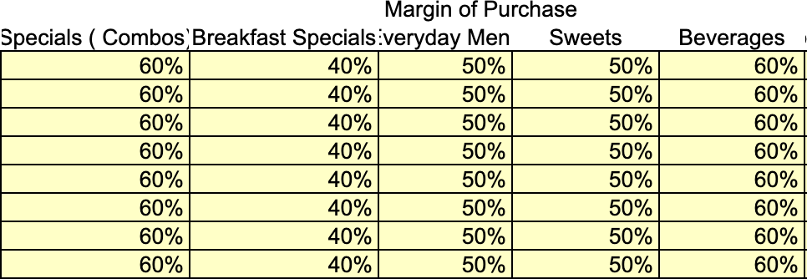
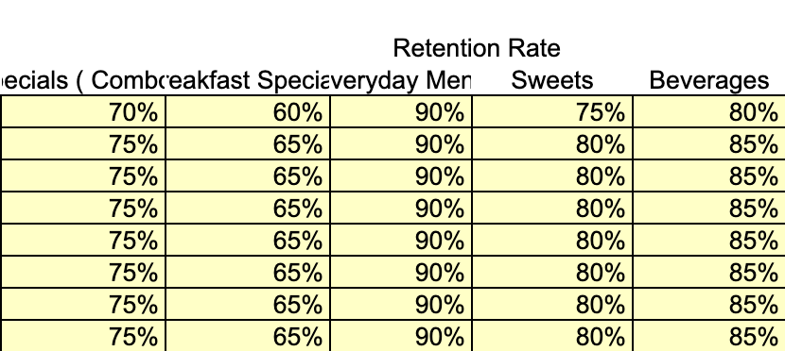
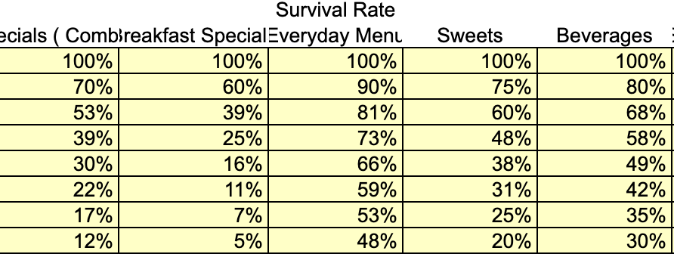
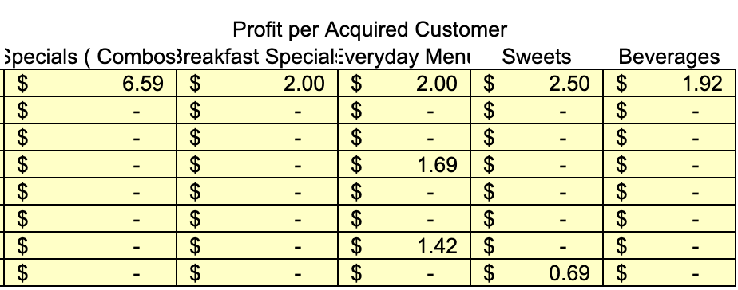
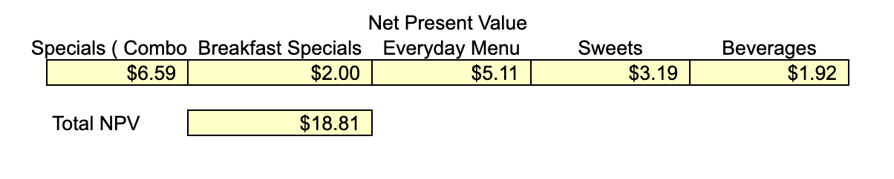
Notes:
Keya Keya
As per the assumptions the data were populated under Calculator for 8 years.We have received satisfactory results.

Slide 36
Lean Canvas

Slide 37
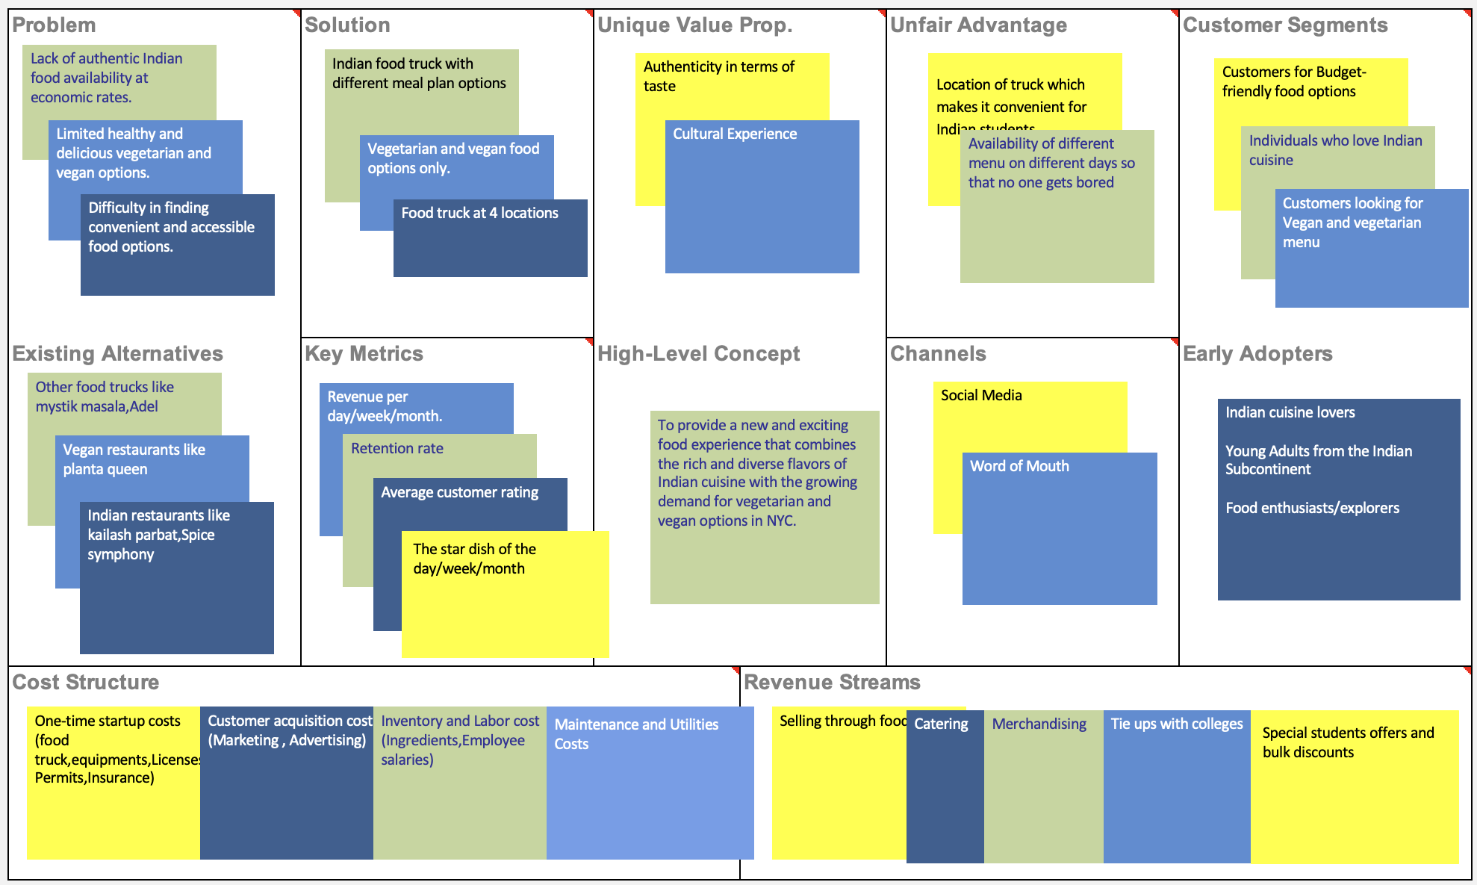
Lean Canvas
Notes:
Jessica

Slide 38
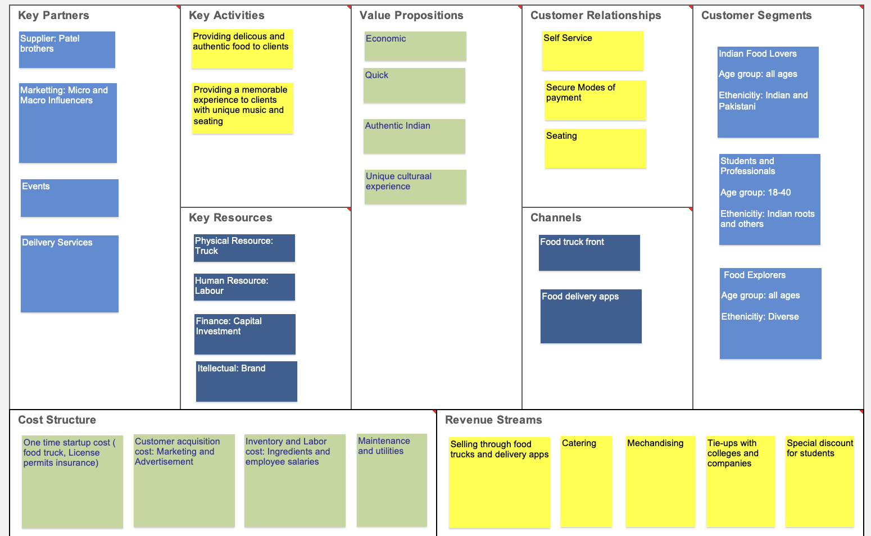
Business Model Lean Canvas
Notes:
Aakash Sardesai, Jessica

Slide 39
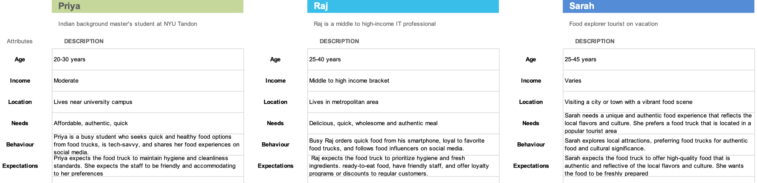
Customer Personas Canvas
Notes:
Aakash Sardesai

Slide 40
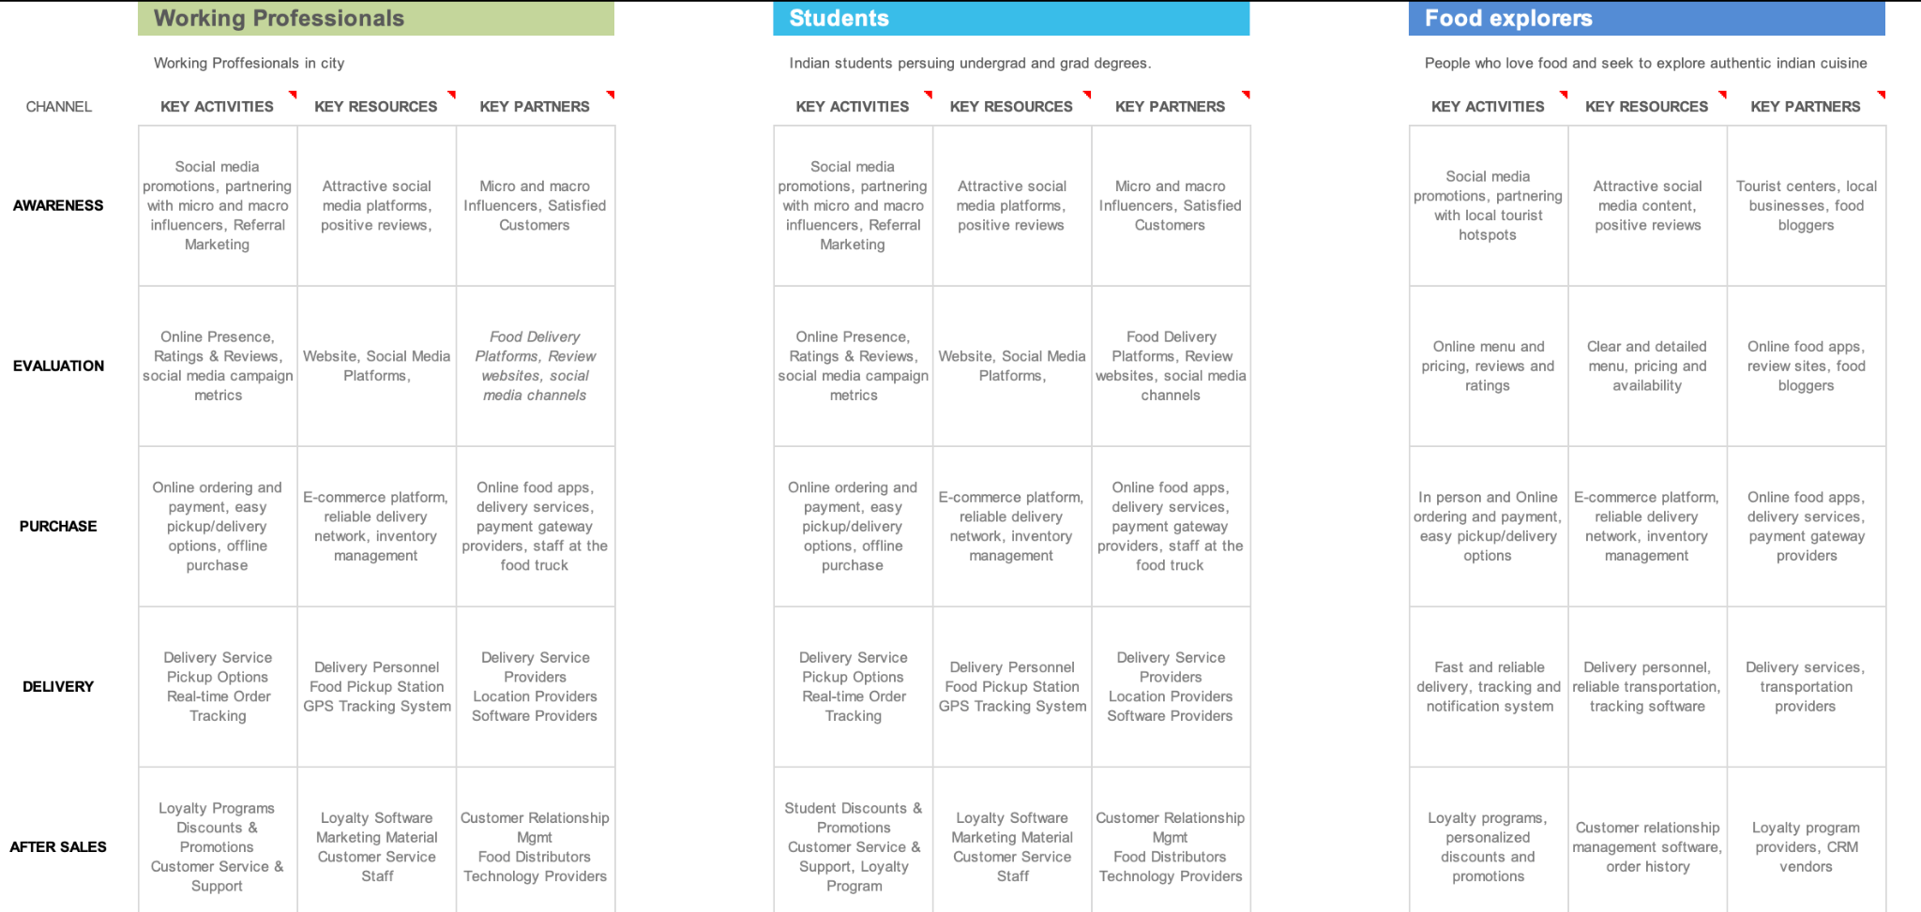
Channel Implementation Canvas
Notes:
Aakash Sardesai

Slide 41
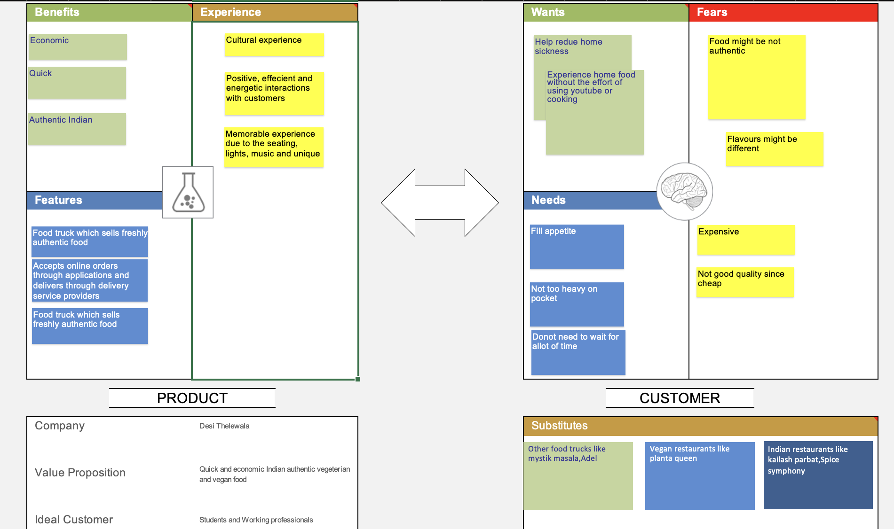
Value Proposition Canvas i
Notes:
Aakash Sardesai

Slide 42
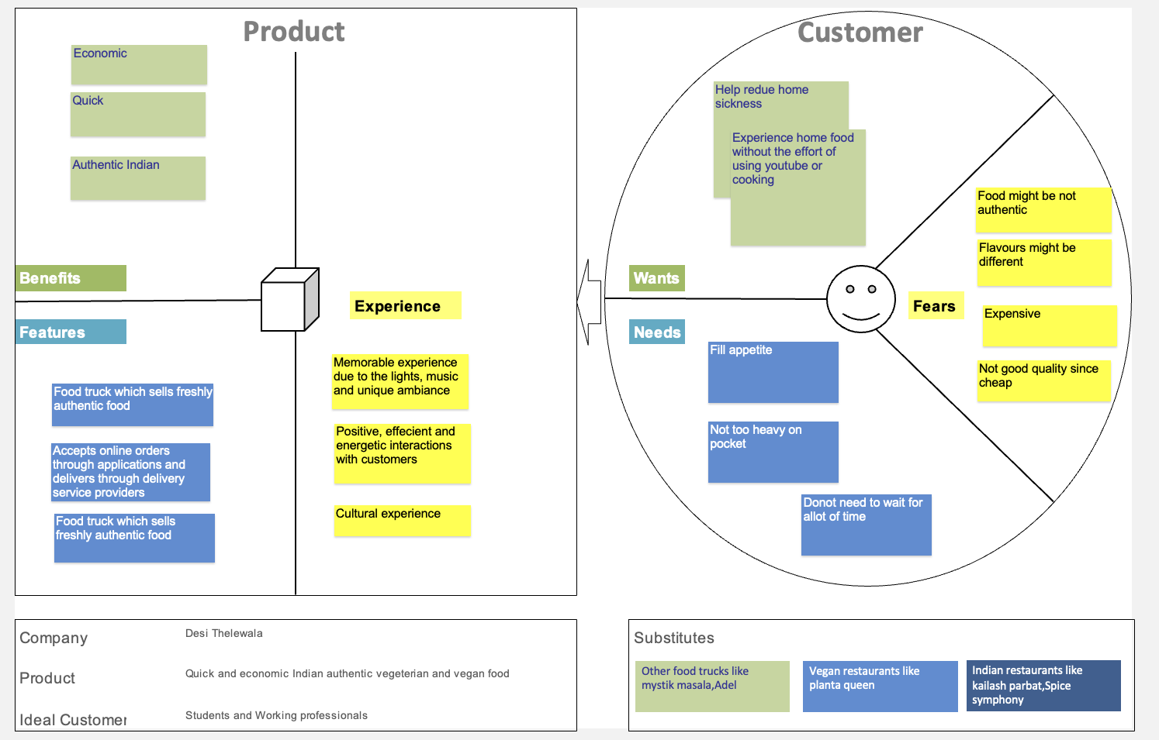
Value Proposition Canvas ii
Notes:
Aakash Sardesai

Slide 43
Thank You

